Slide 1


Getting Started With Azure Cloud
Notes:
This presentation was automatically generated by PowerPoint Copilot based on content found in this document: https://klayytech-my.sharepoint.com/personal/eadel_klayytech_com/Documents/Discussion%20on%20Career%20Path%20and%20Cloud%20Strategy.docx AI-generated content may be incorrect.

Slide 2




Cloud Learning Zone
https://youtube.com/@CloudLearningZone
https://chat.whatsapp.com/CgVTolHVU3e7csp0hKFQAn
https://www.linkedin.com/groups/9806371/
Notes:
This slide lists the different technical and non-technical roles in the field of cloud computing. Technical roles include Cloud Developer, Cloud Administrator, Cloud Engineer, Cloud Support Engineer, Cloud DevOps Engineer, Cloud SysOps Engineer, Cloud Security Engineer, and Cloud Architect. Non-technical roles are also available in the field. Original Content: · TECHNICAL ROLES: o Cloud Developer: o Cloud Administrator: o Cloud Engineer: o Cloud Support Engineer: o Cloud DevOps Engineer: o Cloud SysOps Engineer: o Cloud Security Engineer: o Cloud Architect: · NON-TECHNICAL ROLES:

Slide 3

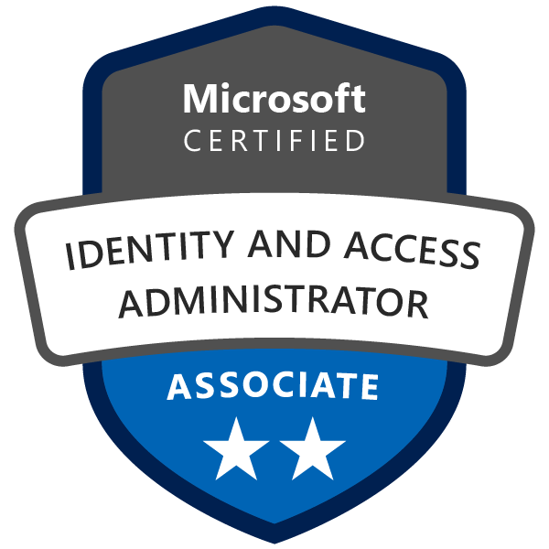
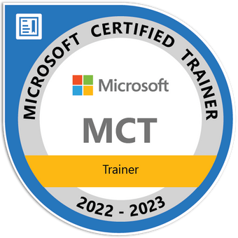



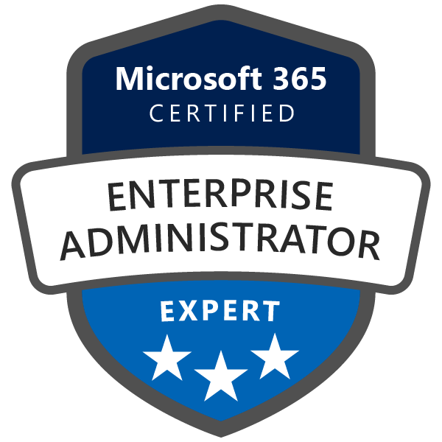
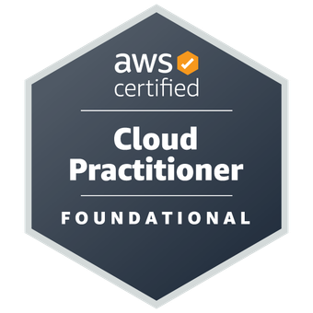
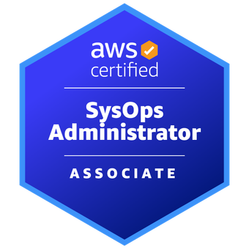
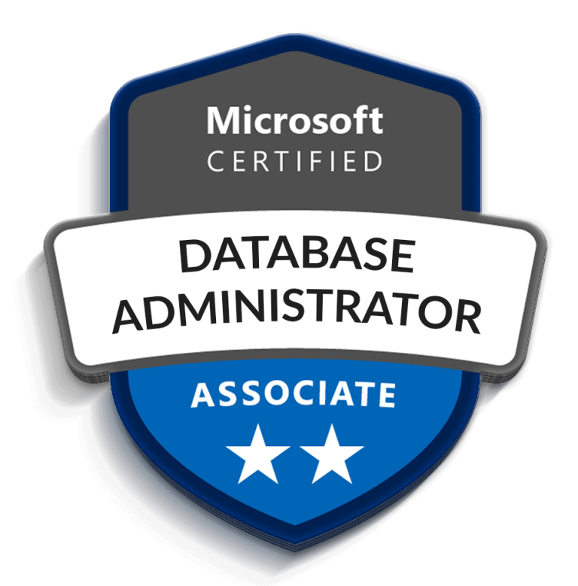





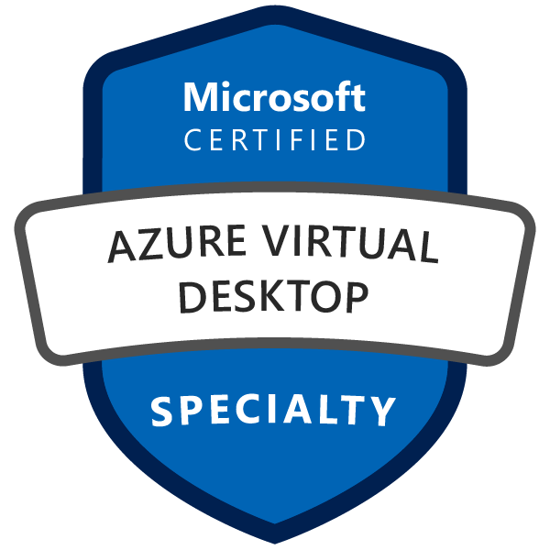



Hello!
Emad Adel
Cloud Solutions Architect
Microsoft Certified Trainer
https://www.linkedin.com/in/emadadel
https://www.emadadel.com
https://www.youtube.com/EmadAdel2008

Slide 4
Agenda
Overview Azure Regions
Azure Subscriptions
Subscription’s Types
Azure Resource Hierarchy
Azure Administrator tools
Azure Resource Manager
Azure Walkthrough
Conclusion
Azure Cloud Services Directory
Notes:
Agenda * Job Titles vs Job Roles vs Skills * Job Titles Hierarchy * Cloud Roles * Technical Roles * Non-Technical Roles * Tech-Savvy Roles * 7 Essential Skills * Cloud Career (Certification) Path * AWS Certifications * Microsoft Certifications * GCP Certifications * Study vs Exam Pass vs Experience * Vendor (Partner) Side or Client Side * What is My Cloud Strategy Roadmap? * Conclusion

Slide 5
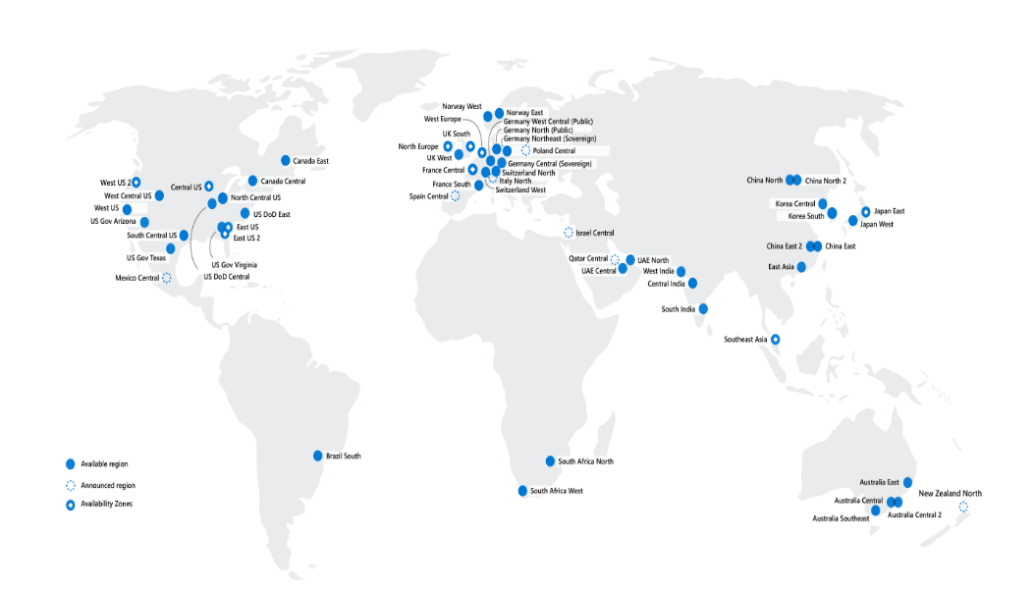
Identify Regions
A region represents a collection of datacenters
Provides flexibility and scale
Preserves data residency
Select regions close to your users
Be aware of region deployment availability
There are global services that are region independent
Worldwide there are 60+ regions representing 140 countries
Most regions are paired for high availability
Notes:
A list of regions and their locations is available at https://azure.microsoft.com/global-infrastructure/locations/
Here is a link to the list of regional pairs: https://learn.microsoft.com/azure/reliability/cross-region-replication-azure#azure-cross-region-replication-pairings-for-all-geographies
Microsoft datacenters animation - https://datacenters.microsoft.com/globe/explore
Virtual datacenter tour - https://datacenters.microsoft.com/globe/explore/datacenter

Slide 6
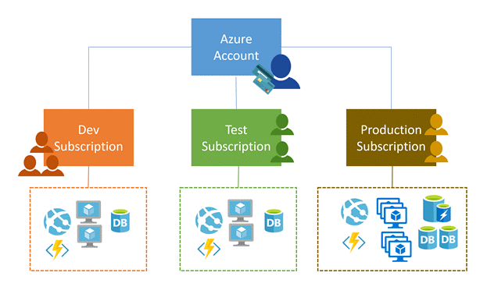
Implement Azure Subscriptions
Only identities in Entra ID, or in a directory that is trusted by Entra ID, can create a subscription
Logical unit of Azure services that is linked to an Azure account
Security and billing boundary*
Notes:
*Clarification on the last bullet - OnlyiIdentities in Microsoft Entra ID or in a directory that is trusted by Entra ID (such as a work or school organization) can create a Subscription. For example, Account Owner role can be used to create a Subscription in an Enterprise Agreement.
Create an additional Azure subscription - https://docs.microsoft.com/azure/cost-management-billing/manage/create-subscription
Change your Azure subscription to a different offer - https://docs.microsoft.com/azure/cost-management-billing/manage/switch-azure-offer
Subscription considerations and recommendations - https://learn.microsoft.com/azure/cloud-adoption-framework/ready/landing-zone/design-area/resource-org-subscriptions Organize and manage multiple Azure subscriptions - https://learn.microsoft.com/azure/cloud-adoption-framework/ready/azure-best-practices/organize-subscriptions
✔️ Do you know how many subscriptions your organization has?

Slide 7
Identify Subscription Usage
Subscription | Usage
Free | Includes a $200 credit for the first 30 days, free limited access for 12 months
Pay-As-You-Go | Charges you monthly
CSP | Agreement with possible discounts through a Microsoft Cloud Solutions Provider Partner – typically for small to medium businesses
Enterprise | One agreement, with discounts for new licenses and Software Assurance – targeted at enterprise-scale organizations
Student | Includes $100 for 12 months – must verify student access
Notes:
Credit card information is used for identity verification only. You won’t be charged for any services until you upgrade.

Slide 8
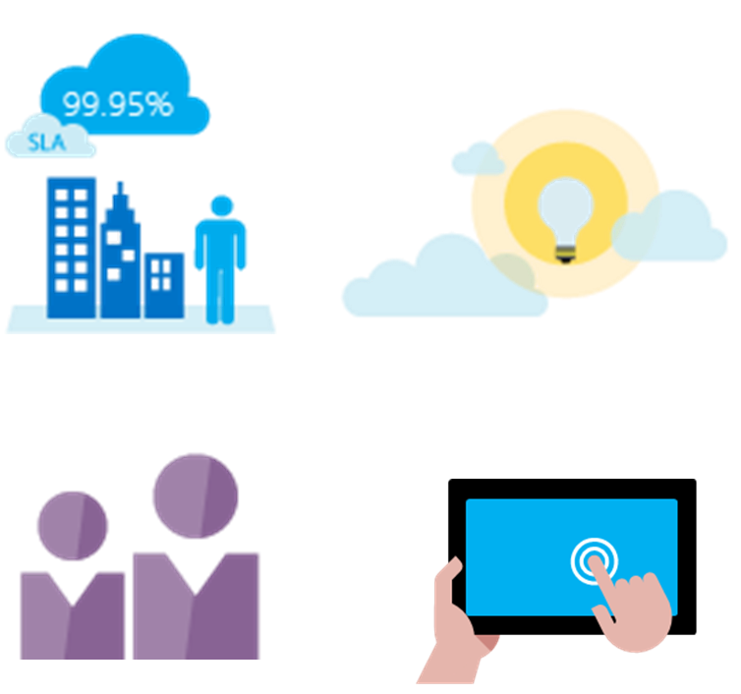
Obtain a Subscription
Enterprise Agreement customers make an upfront monetary commitment and consume services throughout the year
Resellers provide a simple, flexible way to purchase cloud services
Partners can design and implement your Azure cloud solution
Personal free account – Start right away
Notes:
Subscription decision guide - https://docs.microsoft.com/azure/cloud-adoption-framework/decision-guides/subscriptions/
Explore flexible purchasing options for Azure - https://azure.microsoft.com/pricing/purchase-options/
✔️ Which subscription model are you most interested in?

Slide 9
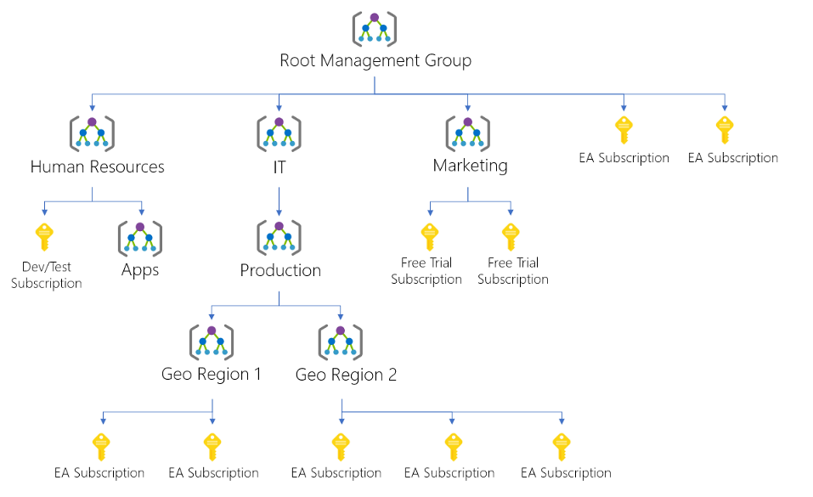
Create an Azure Resource Hierarchy
Management groups provides a level of scope above subscriptions
Target policies and spend budgets across subscriptions and inheritance down the hierarchies
Implement compliance and cost reporting by organization (business/teams)
* To prevent changes, apply resource locks at the subscription, resource group, or resources level
Notes:
Create management groups for resource organization and management - https://docs.microsoft.com/azure/governance/management-groups/create
Manage your resources with management groups - https://docs.microsoft.com/azure/governance/management-groups/manage

Slide 10
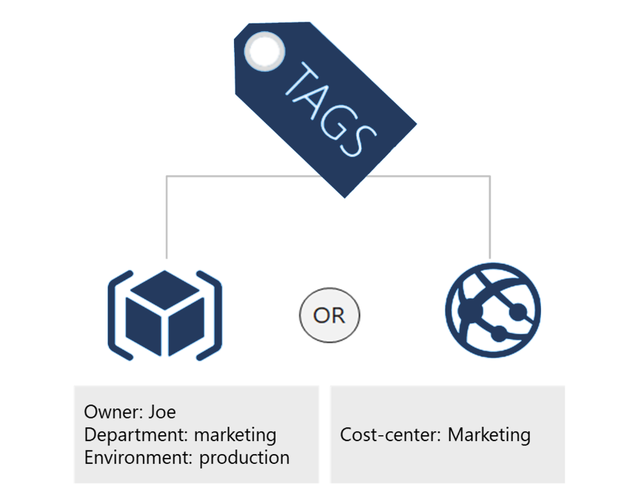
Apply Resource Tagging
Provides metadata for your Azure resources
Logically organizes resources
Consists of a name-value pair
Very useful for rolling up billing information
Notes:
Resource naming and tagging decision guide - https://docs.microsoft.com/azure/cloud-adoption-framework/decision-guides/resource-tagging
✔️ If you need to create a lot of tags you will want to do that programmatically. You can use PowerShell or the CLI.

Slide 11
Manage Costs
Costs are resource-specific
Usage costs may vary between locations
Costs for inbound and outbound data transfers differ
Pre-pay with Azure reserved instances
Use your on-premises licenses with Azure Hybrid Benefit
Optimize with alerts, budgets, and Azure Advisor recommendations
Notes:
Azure usage charges - https://docs.microsoft.com/azure/billing/billing-understand-your-invoice
There are six primary factors affecting costs:
Resource Type: Costs are resource-specific, so the usage that a meter tracks and the number of meters associated with a resource depend on the resource type.
Services: Azure usage rates and billing periods can differ between Enterprise, Web Direct, and CSP customers.
Location: The Azure infrastructure is globally distributed, and usage costs might vary between locations that offer Azure products, services, and resources.
Bandwidth: Some inbound data transfers are free, such as data going into Azure datacenters. For outbound data transfers, such as data going out of Azure datacenters, pricing is based on Zones.
Azure Reservations: Azure Reservations allow you to prepay for one-year or three-years of virtual machine or SQL Database compute capacity. Pre-paying will allow you to get a discount on the resources you use. Azure reservations can significantly reduce your virtual machine or SQL database compute costs — up to 72 percent on pay-as-you-go prices with one-year or three-year upfront commitment. Reservations provide a billing discount and don't affect the runtime state of your virtual machines or SQL databases.
Azure Hybrid Benefit: If you already have Windows Server or SQL Server licenses in your on-premises deployments, you can use the Azure Hybrid Benefit program to save in Azure. With the Windows Server benefit, each license covers the cost of the OS (up to two virtual machines), and you only pay for base compute costs. You can use existing SQL Server licenses to save up to 55 percent on vCore-based SQL Database options. Options include SQL Server in Azure Virtual Machines and SQL Server Integration Services.

Slide 12
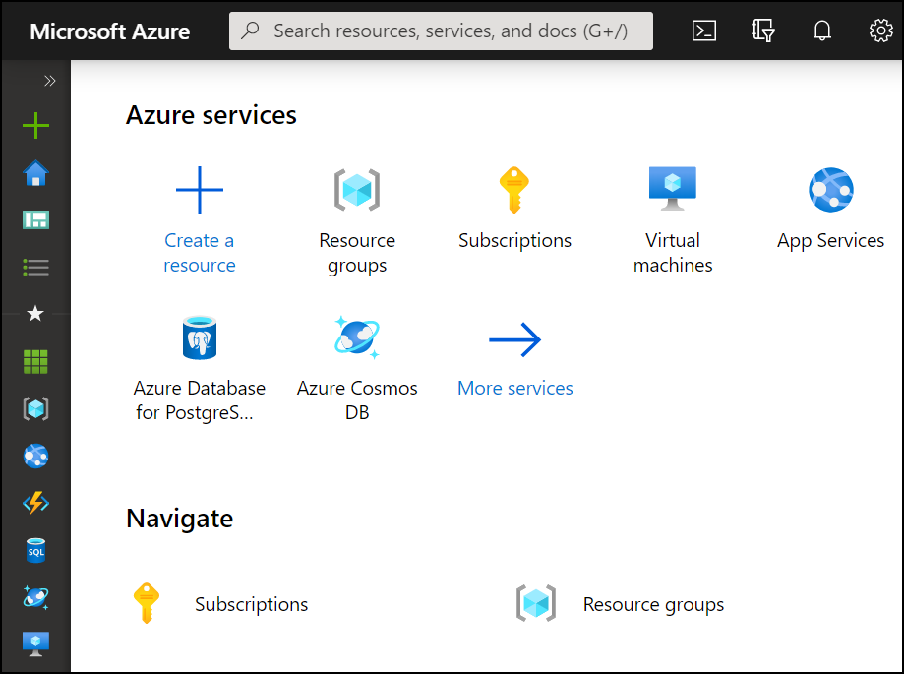
Compare Administrator tools
Azure Portal
View and manage resources Visual interface Unified hub – training and documentation Personalize your experience Mobile app Access the Cloud Shell One-off creation scenarios
Azure Cloud Shell
Interactive and browser-accessible with file storage Offers Bash or PowerShell Authenticates automatically Provided on a per-session and per-user basis Temporary - times out after 20 minutes
Azure PowerShell and CLI
Command line programs Interactive and scripting modes Cross-platform Good for repeatable deployments Familiar coding experience
az vm restart -g MyResourceGroup -n MyVm
Notes:
Quick overview of the administrator tools. There are separate Learn modules for the tools.
Azure Portal Overview - https://docs.microsoft.com/azure/azure-portal/azure-portal-overview
Overview of Azure Cloud Shell - https://docs.microsoft.com/azure/cloud-shell/overview
Get started with Azure PowerShell - https://docs.microsoft.com/powershell/azure/get-started-azureps?view=azps-4.3.0
Get started with Azure CLI - https://docs.microsoft.com/cli/azure/get-started-with-azure-cli?view=azure-cli-latest

Slide 13
Review ARM Template Advantages
Improves consistency and promotes reuse
ARM
Template
Reduce manual, error prone, and repetitive tasks
Express complex deployments
Development
Express requirements through code
Production
Provides validation tasks
Modular and can be linked
Quality
Assurance
Simplifies orchestration
Notes:
What are ARM templates? - https://docs.microsoft.com/azure/azure-resource-manager/templates/overview

Slide 14
Explore the JSON Template Schema
{
"$schema": "http://schema.management.
azure.com/schemas/2019-04- 01/deploymentTemplate.json#",
"contentVersion": "",
"parameters": {},
"variables": {},
"functions": [],
"resources": [],
"outputs": {}
}
Defines all the Resource manager resources in a deployment
Written in JSON
A collection of key-value pairs
Each key is a string
Each value can be a string, number, Boolean expression, list of values, object
Notes:
Understand the structure and syntax of ARM templates - https://docs.microsoft.com/azure/azure-resource-manager/templates/template-syntax

Slide 15
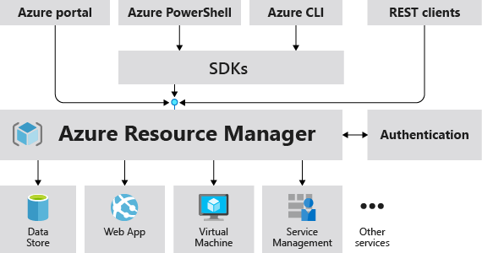
Azure Resource Manager
The Azure Resource Manager (ARM) provides a management layer that enables you to create, update, and delete resources in your Azure subscription.
Notes:
https://learn.microsoft.com/training/modules/describe-features-tools-manage-deploy-azure-resources/4-describe-azure-resource-manager-azure-arm-templates
Provides a management layer that enables you to create, update, and delete resources in your Azure subscription.
Create, configure, manage and delete resources and resource groups.
Organizes resources.
Controls access and resources.
Automates using different tools and SDKs.
Stores layouts in JSON files.
You can view more details about Azure Resource Manager at https://learn.microsoft.com/azure/azure-resource-manager/

Slide 16
Azure Demo
Azure Walkthrough
Azure Cloud Services Directory
Notes:
Today, we'll be discussing our cloud strategy roadmap. This will outline our plans for implementing cloud technology in our organization. Original Content: • What is My Cloud Strategy Roadmap?

Slide 17

Conclusion
https://www.linkedin.com/in/emadadel
https://www.emadadel.com
https://www.youtube.com/EmadAdel2008
Notes:
This slide concludes the presentation. Original Content: Conclusion

